Slide 1
Impacts in Punching Ball
Weeks 1 & 2

Slide 2
Part 1: Comparing Sensors
Comparison of sensors when measuring the same thing
Both sensors stuck together
Sensors numerically superposed
Conclusion: Both sensors give the same results
Comparison of sensors measuring different things
Sensors over and under helmet
Wireless sensor with elastic band, and with tape
Conclusion: Same force over and under helmet with tape, slightly higher with band

Slide 3
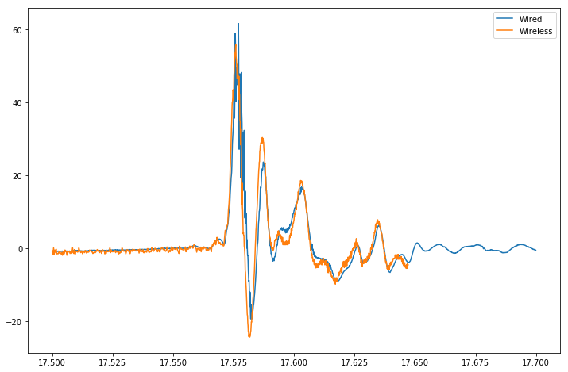
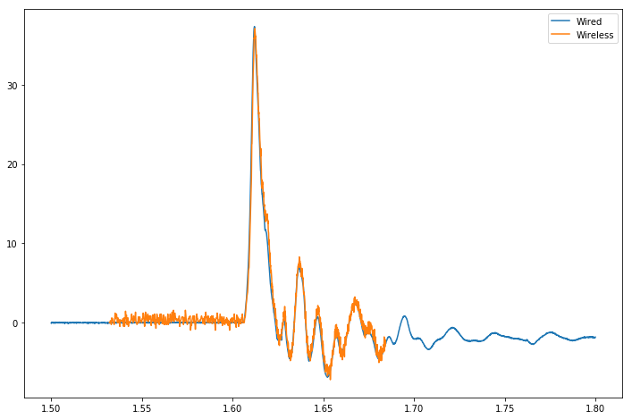
Both sensors together – Normal

Slide 4
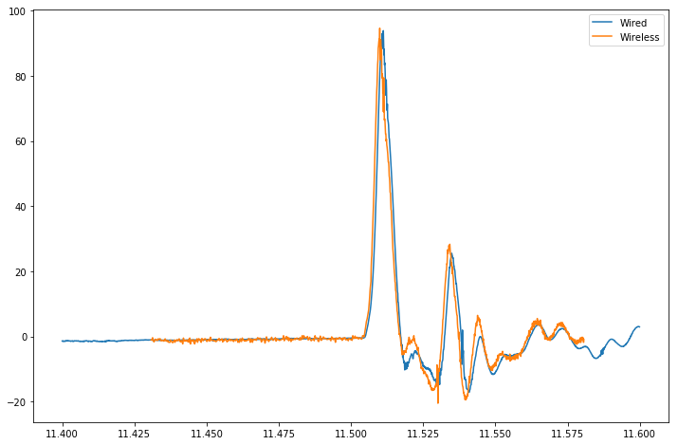
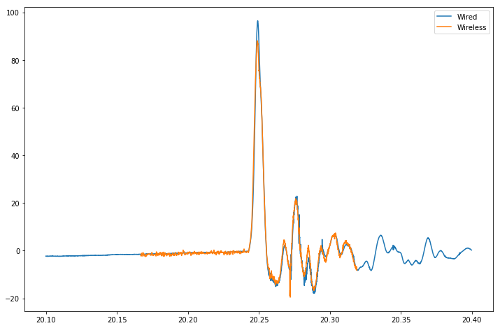
Both Sensors Together – Off-Center Impacts

Slide 5
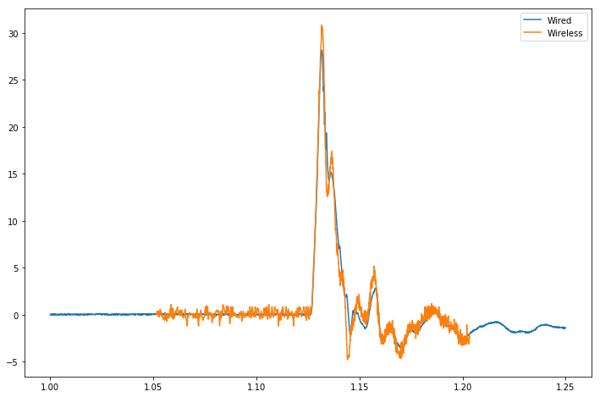
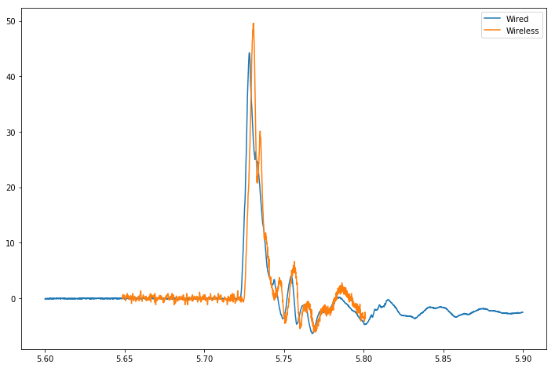
Cabled Sensor Under Helmet Wireless Sensor Banded Over Helmet

Slide 6
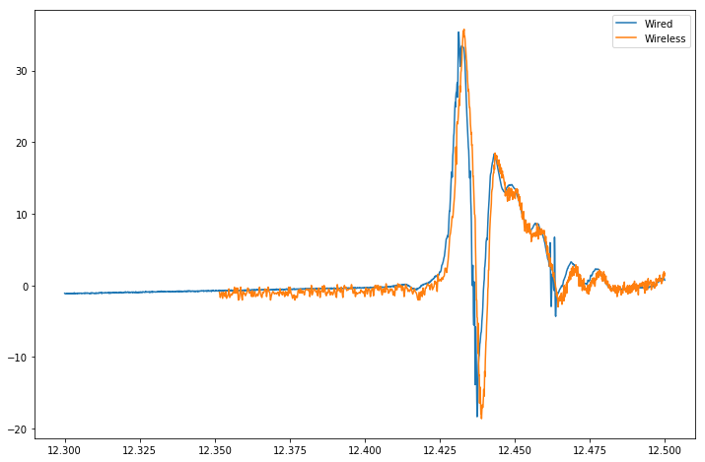
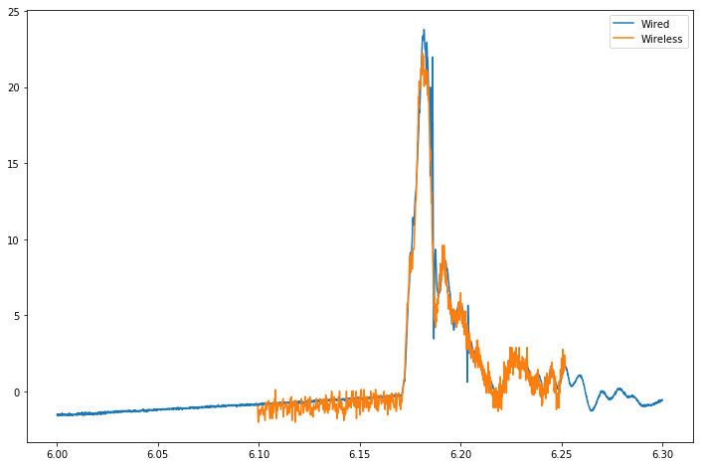
Cabled Sensor Under Helmet Wireless Sensor Taped Over Helmet

Slide 7
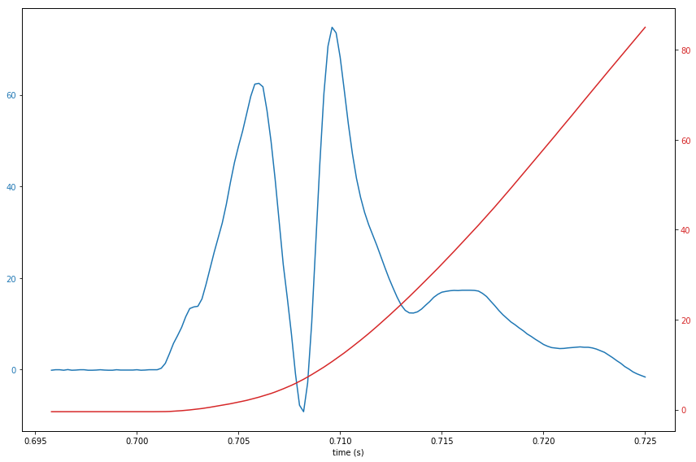
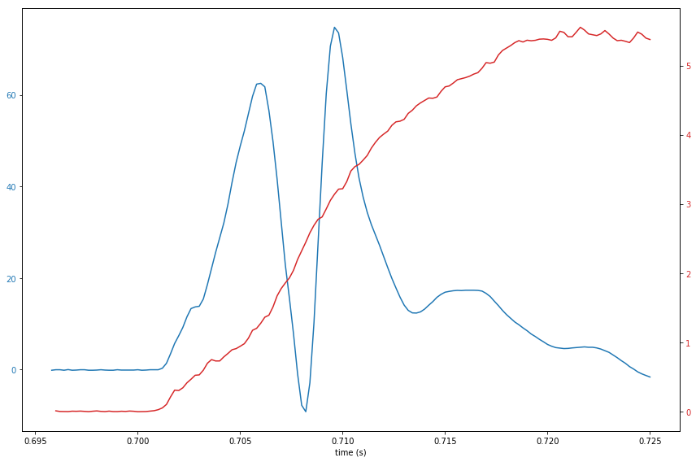
Part 2: Understanding Results
Impacts with varying speed and time were recorded
Consistent Double Peaks

Slide 8
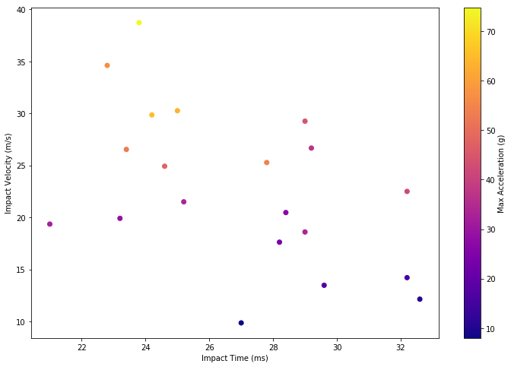
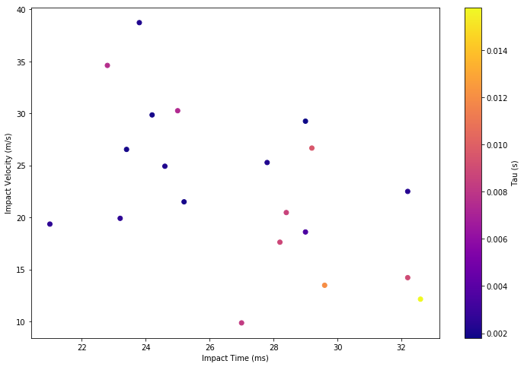
For 20 Different Impacts

Slide 9
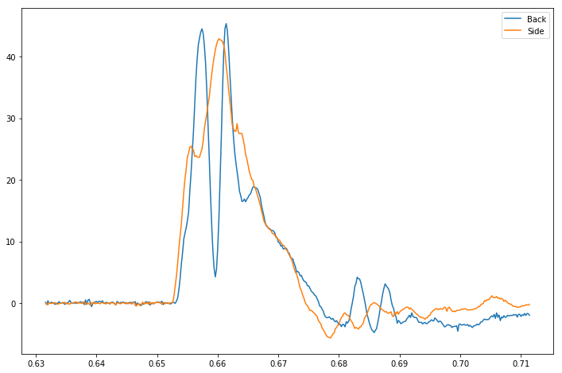
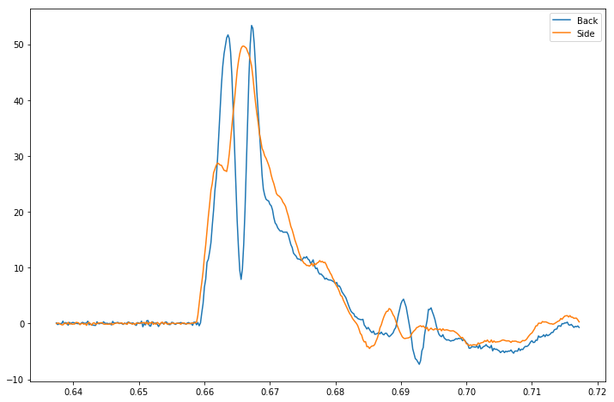
Part 3: Understanding Double Peaks
Placed one sensor on the side, one at the back
Leads us to believe that double peak is caused by a shockwave propagating through the punching ball

Slide 10
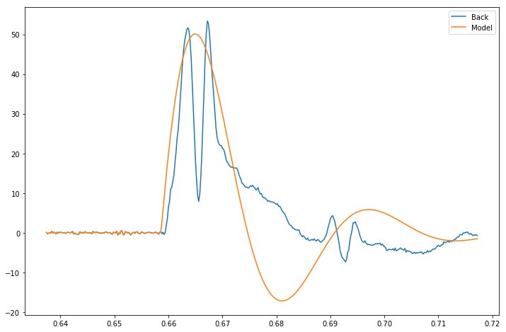
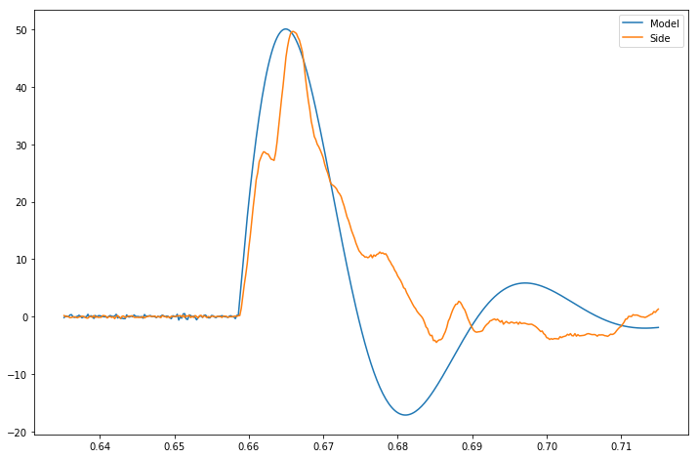

Recovering single peak from double peak
We approximate the single peak by $a\left(t\right)=Ae^{−βt}\sin\left(\frac{t}{τ}\right)$
We therefore need to recover 3 parameters: $A,β,τ$
This was done by gradient descent on the data obtained from the experiment.
This allows us to approximate the peak acceleration and the value of tau for otherwise unusable double peak data

Slide 11
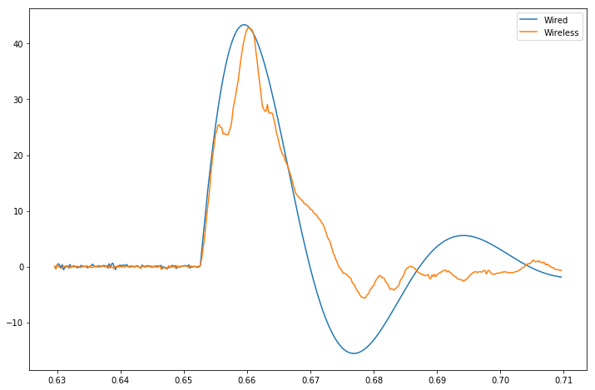
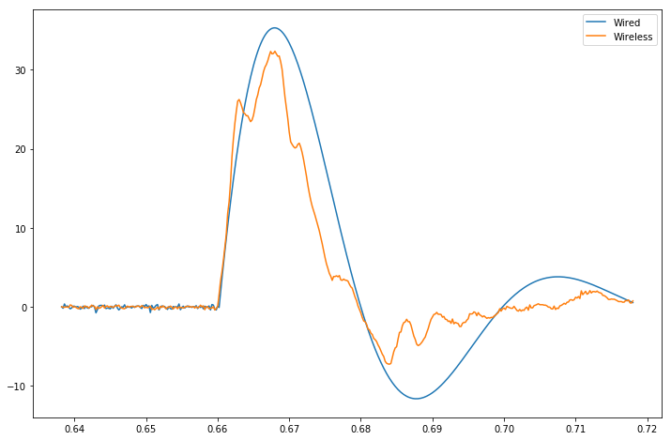
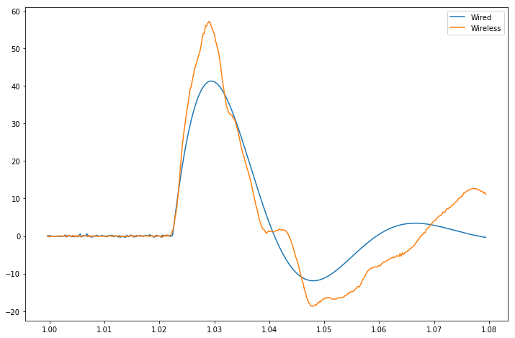
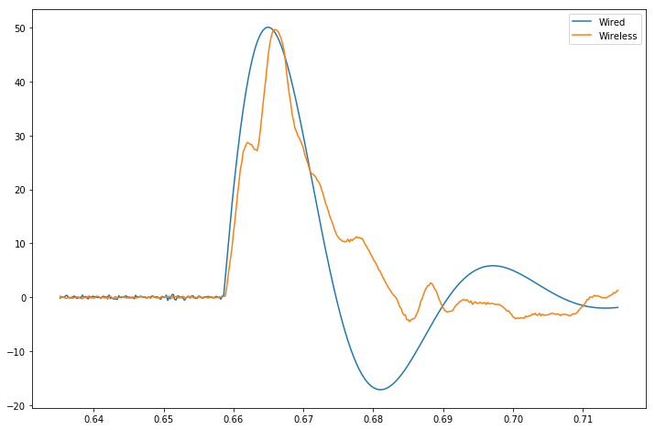
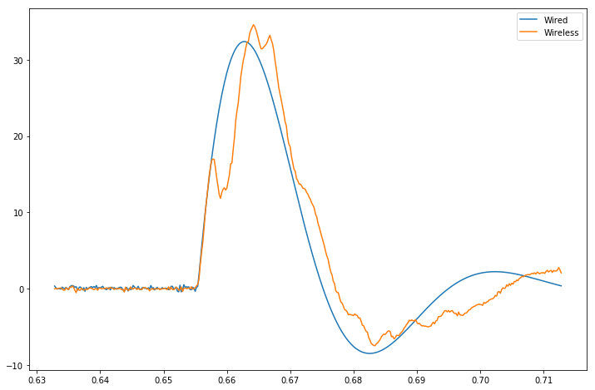
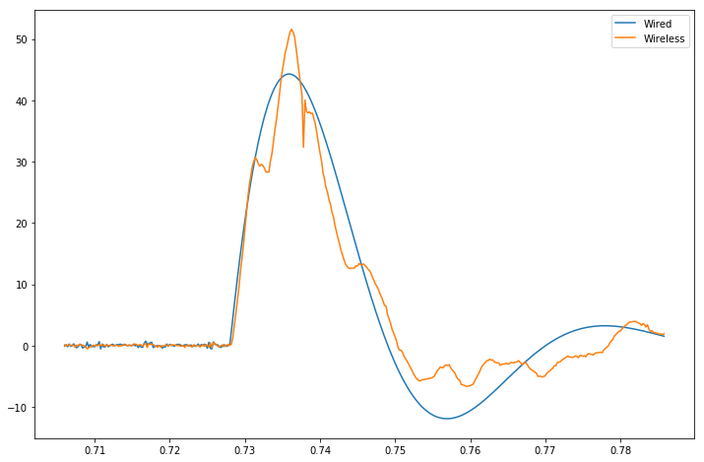

Slide 12
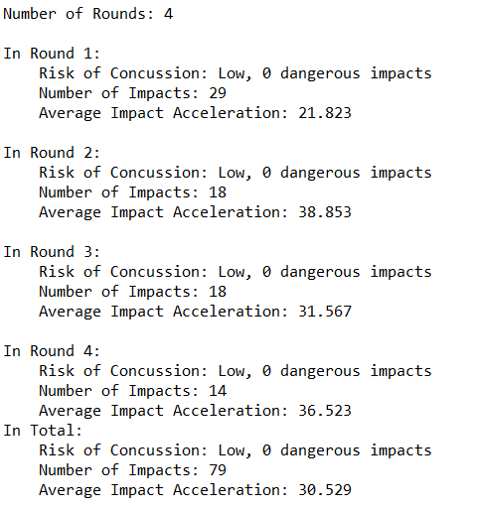
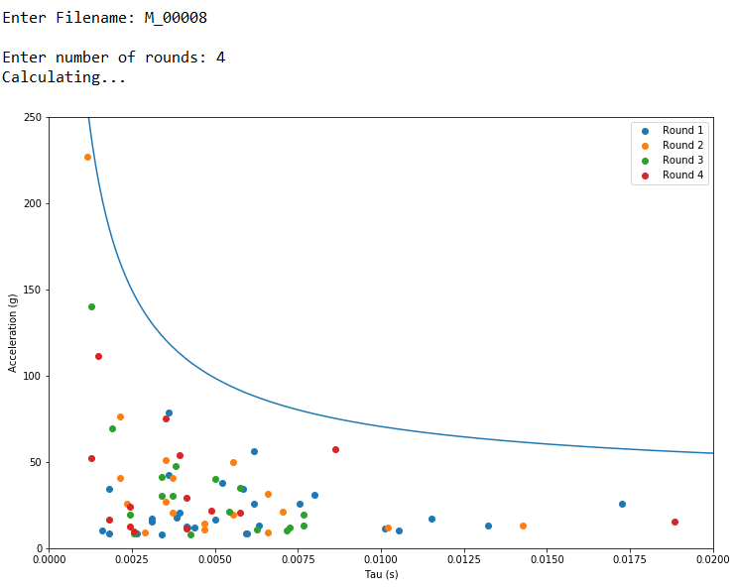
Part 4: Analysing boxer data
Wrote a short ‘user friendly’ code to analyse data from rounds with the Phyling wireless sensor

Slide 13
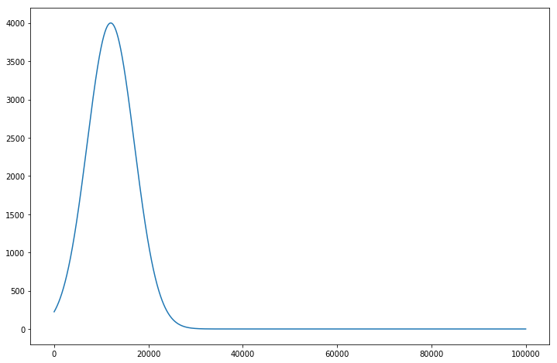
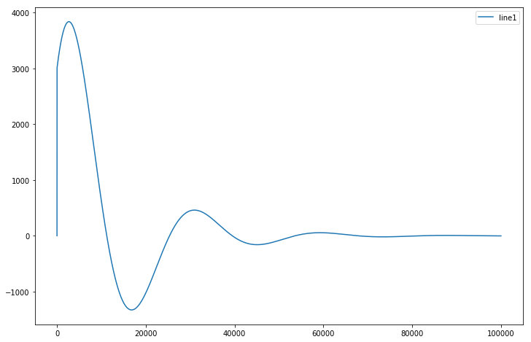
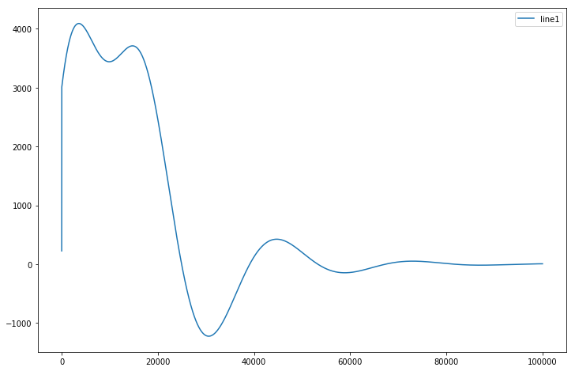
Annex: Modelling
With gaussian force applied:
With no force applied

Slide 14
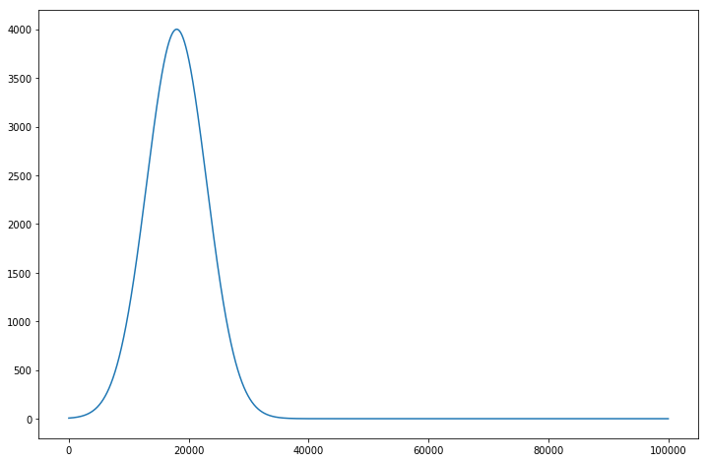
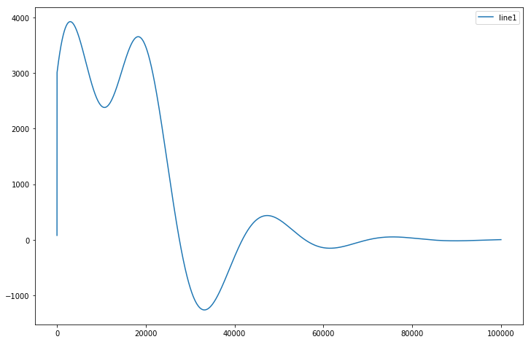
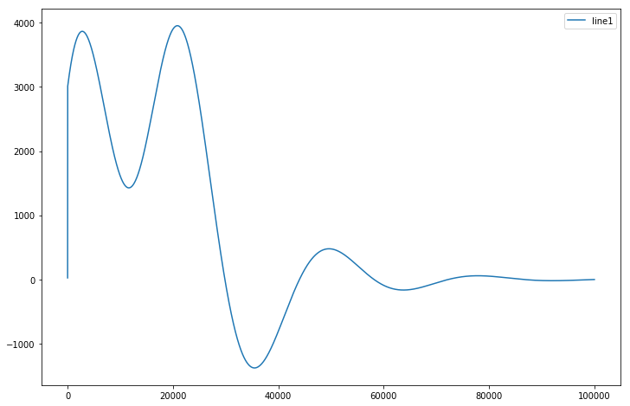
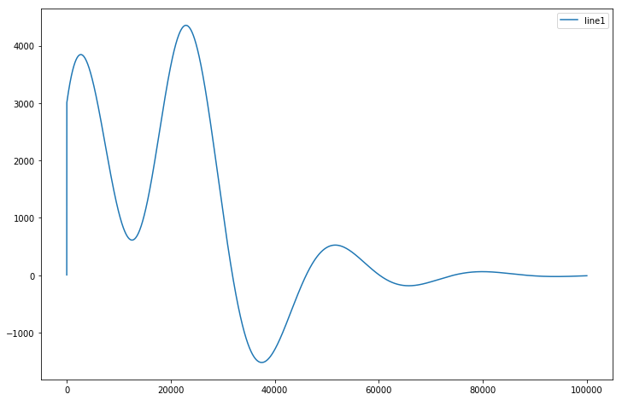
Double Peaks in the model
t_0
Increase t_0
Increase t_0
Increase t_0

